Slide 1
Employee Data Analysis using Excel
STUDENT NAME: SARIKA G
REGISTER NO: 2213391036321/
2D9C5A97018ACAB9545435913D82C414
DEPARTMENT: B COM COMMERCE
COLLEGE: QUEEN MARY’S COLLEGE

Slide 2
PROJECT TITLE
Employee Performance Analysis using Excel

Slide 3


AGENDA
Problem Statement
Project Overview
End Users
Our Solution and Proposition
Dataset Description
Modelling Approach
Results and Discussion
Conclusion
3/21/2024 Annual Review

Slide 4

PROBLEM STATEMENT
Performance analysis are made to a employees.
Increment to check the performance track of the employees and it is useful for the employees personal as well as organizational growth.
So, the employees performance analysis helps to require all the problems and have a successful organisation.

Slide 5

PROJECT OVERVIEW
Analysing the performance of the employees by
considering the various factors like;
Gender,
Performance score and
Rating.
Their involvement in work and various scores that analysis the performance of employees in the organization.
.

Slide 6


WHO ARE THE END USERS?
Employees Employer Manager,
Gets benefits from the performance appraisal

Slide 7

OUR SOLUTION AND ITS VALUE PROPOSITION
Conditional Formatting – missing values
Filtering : remove missing data
Formulas : performance evaluation
Pivot : summary
Graph : data visualization

Slide 8
Dataset Description
EMPLOYEES DATABASE KIGGLE
There are 26 features but we consider 9 features
Employees ID Numerical data
Name Text
Performance Level
Gender Male Or Female
Employees rating. Numerical data

Slide 9

THE "WOW" IN OUR SOLUTION
Sample Queries:
Get all characters in a guild: `SELECT * FROM Characters JOIN Members ON Character ID = Character ID WHERE Guild ID = [Guild ID]`
2. Get all raids a character has participated in: `SELECT * FROM Raids JOIN Raid Members ON Raid ID = Raid ID WHERE Character ID= [Character ID]
`This database design captures key WoW data and relationships, enabling you to store and query character, guild, and raid information.
3/21/2024 Annual Review
9

Slide 10
MODELLING
1.Data collection
2.Feature collection
3.Data cleaning
4.Performance level
5.Summary
6.Visualisation
10

Slide 11
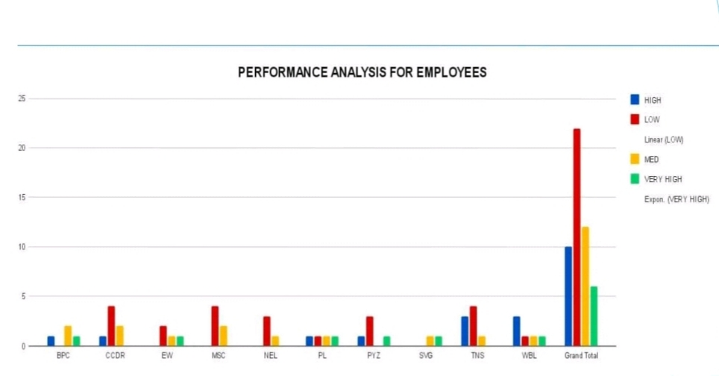
RESULTS
11

Slide 12
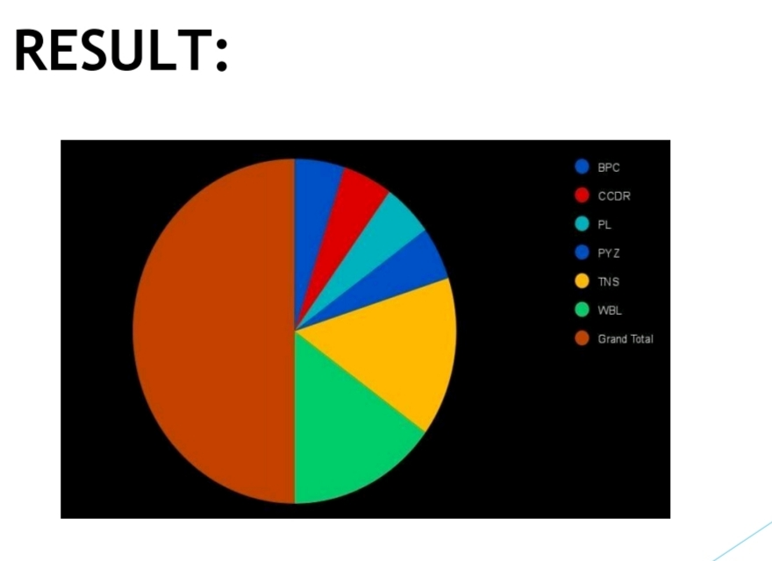

Slide 13
conclusion
While comparing the performance of employees, the number of employees are higher in number is in the average performance where excellence employees are less in percentage. So to overcome this we should motivate the employees by giving there different tasks based on their skills to improve their performance in their work.

